Slide 1

Loan Default Prediction Using Supervised Machine Learning Methods
September 2024

Slide 2
Content
Executive Summary Problem Statement Data Overview
Methodology Model Development & Selection Hyperparameter Tuning
Results Conclusion

Slide 3
Executive Summary
Objective:
The goal of this project is to develop a machine learning model to predict loan defaults based on customer credit data. By accurately predicting whether a customer will default, financial institutions can make better-informed lending decisions, minimize financial risk, and optimize loan approval processes.
Key Techniques:
SMOTE
01
02
03
04
Machine Learning Methods
Handling Class Imbalance
Logistic Regression
Decision Trees
Random Forest
XGBoost
Synthetic Minority Oversampling Technique
To handle the challenge of class imbalance, we used SMOTE (Synthetic Minority Oversampling Technique) and class weighting to ensure the model could correctly identify loan defaults, which were underrepresented in the dataset.
Hyperparameter tuning was performed for XGBoost using GridSearchCV.
GridSearchCV was adopted to optimize precision, recall, and overall model performance.

Slide 4
Executive Summary
01
Logistic Regression provided high accuracy (88.5%) but struggled with recall for defaults, achieving only 3% recall. This model performed well at identifying non-defaults, with an AUC-ROC of 0.753.
02
Random Forest had similar accuracy (88.5%) but still struggled with detecting defaults (recall 3%). After applying class weighting, Random Forest achieved a recall of 10% for defaults and an AUC-ROC of 0.735.
XGBoost with SMOTE and hyperparameter tuning showed the best performance for recall of defaults. It achieved 74% recall with an AUC-ROC of 0.751. While its accuracy dropped to 64%, it successfully identified a significant number of defaults, making it the best model for default detection.
03
The tuned XGBoost model was the best choice for balancing precision and recall, especially in cases where identifying loan defaults is a top priority.

Slide 5
Problem Statement
Problem:
Predicting loan defaults is essential for financial institutions to manage financial risk and improve lending decisions. By accurately identifying customers who are likely to default, lenders can reduce losses, adjust loan terms, and improve overall credit risk management.
01
Class Imbalance: A significant challenge in this project was the class imbalance, with 225,694 non-defaults (0s) and only 29,653 defaults (1s) in the dataset. This imbalance makes it difficult for machine learning models to detect defaults accurately, as they tend to favor the majority class.
02
Data Sensitivity: Financial datasets are often sensitive to missing values, outliers, and skewed distributions, which can affect the accuracy of predictions.
03
Trade-off Between Precision and Recall: The model needed to balance recall (correctly identifying defaults) with precision (minimizing false positives), ensuring both effective risk management and customer fairness.
04
Feature Selection and Engineering: Identifying the most relevant features was crucial for improving model performance. Features such as income, loan amount, and credit score required careful consideration to ensure they contributed to predicting defaults without introducing noise.

Slide 6
Data Overview
Dataset:
The dataset contains 255,347 rows and 18 columns, representing various financial, demographic, and credit-related information about loan applicants. The features of the dataset are:
The target variable is Default, where:
Age
Income
Loan Amount
Credit Score
Interest Rate
DTIRatio
1 represents a default on the loan
0 represents a non-default.

Slide 7
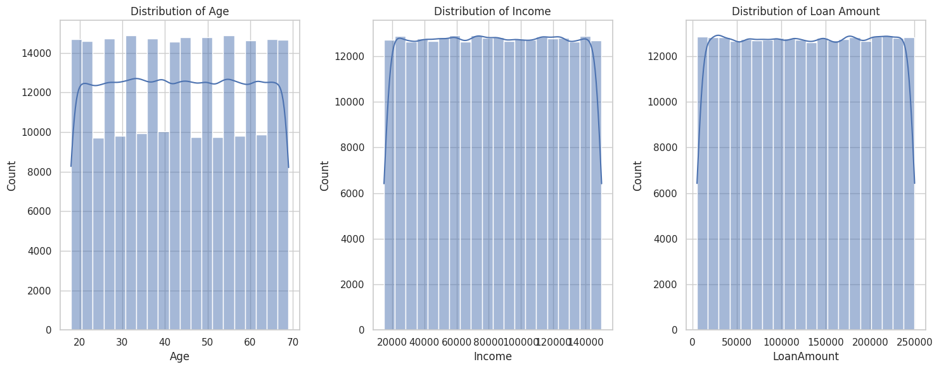
Data Overview: Exploratory Data Analysis
Insight: Applicants range in age from around 20 to 70, with no extreme outliers.
Insight: Income values range from around 20,000 to 150,000, with most applicants clustered in the middle-income range.
Insight: There is no significant skew in loan amounts, indicating diverse lending patterns.

Slide 8
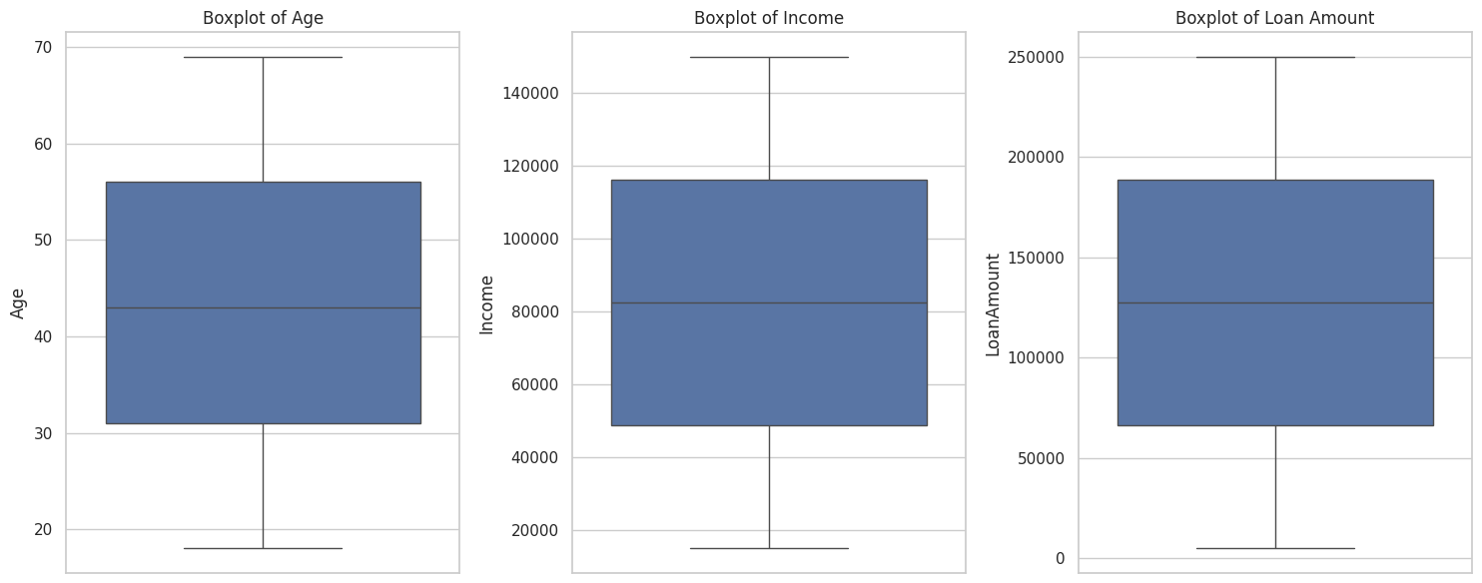
Data Overview: Exploratory Data Analysis
Insight: Applicants range in age from around 20 to 70, with no extreme outliers.
Insight: Income values range from around 20,000 to 150,000, with most applicants clustered in the middle-income range.
Insight: There is no significant skew in loan amounts, indicating diverse lending patterns.

Slide 9
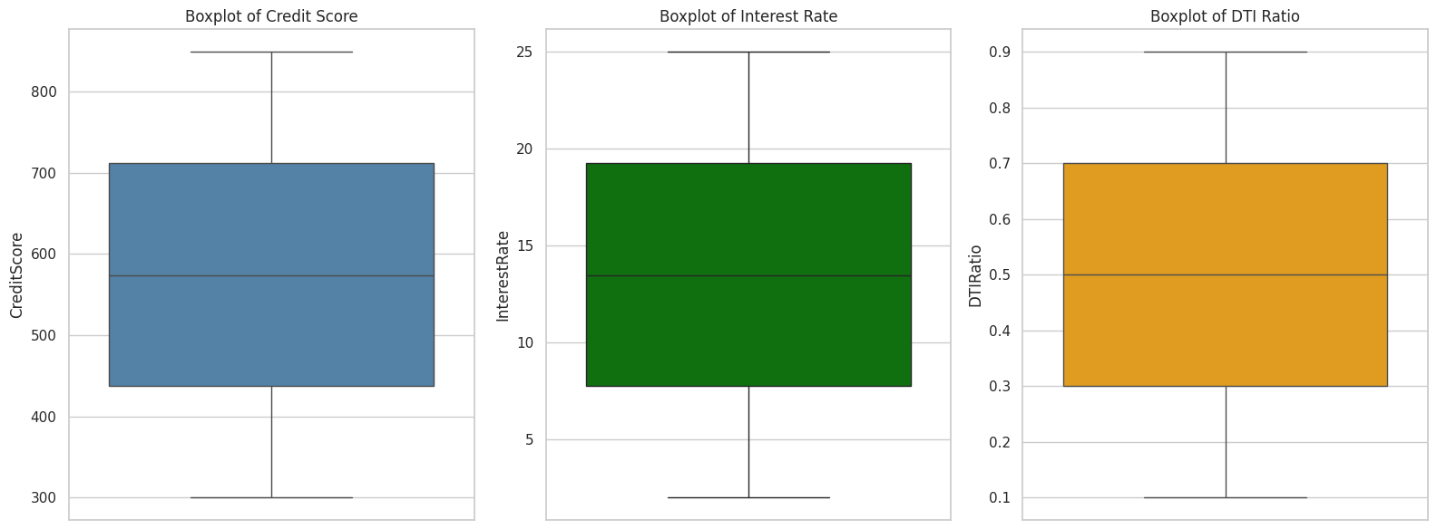
Data Overview: Exploratory Data Analysis
Insight: The credit scores range from 300 to 850, with a median score close to 600. There are no extreme outliers.
Insight: Interest rates range from 2% to 25%, with a median around 13%. This wide spread likely reflects the varying risk profiles of applicants.
Insight: DTIRatio values are well-distributed, with the median around 0.5. A high DTI ratio could indicate a higher likelihood of default.

Slide 10
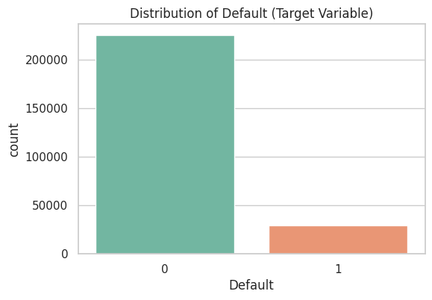
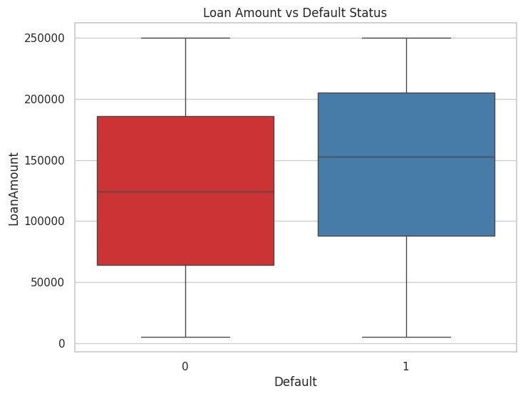
Data Overview: Exploratory Data Analysis
Chart: A bar plot shows the distribution between non-defaults (0) and defaults (1). Non-defaults significantly outnumber defaults, which reflects a class imbalance in the dataset.
Insight: The dataset contains 225,694 non-defaults and 29,653 defaults, highlighting the challenge of predicting the minority class (defaults).

Slide 11
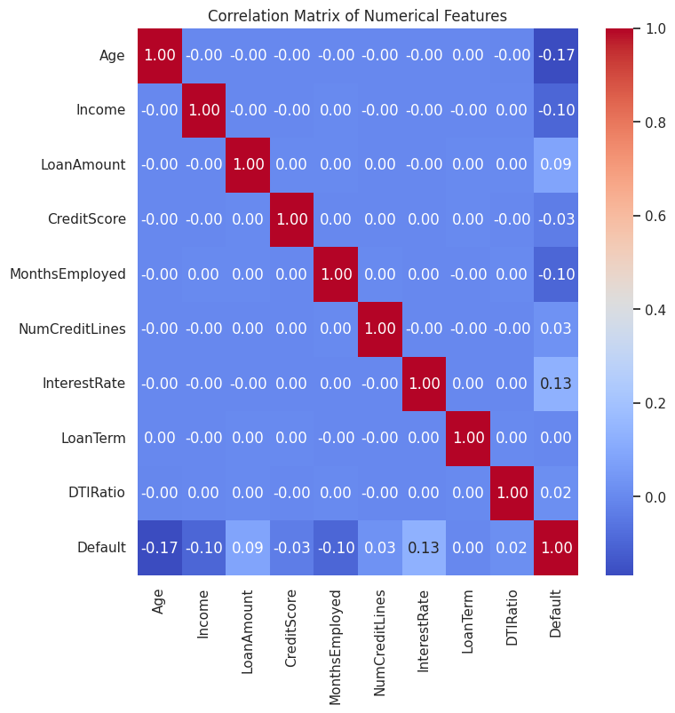
Data Overview: Exploratory Data Analysis
Correlation:
Chart: A correlation heatmap shows weak correlations between individual features and the target variable. The strongest correlation is seen between Interest Rate and Default, which is still weak but important for prediction.
Due to weak correlation, non-linear machine methods are adopted.
The dataset is diverse and covers various financial and demographic factors influencing loan defaults. However, the class imbalance between defaults and non-defaults poses a challenge for accurate prediction, which will be addressed using techniques like SMOTE.

Slide 12
Methodology
Exploratory Data Analysis (EDA):
Distribution Analysis: Key features like Age, Income, and Loan Amount were well-distributed across their ranges, indicating a diverse set of loan applicants.
Class Imbalance: The target variable Default showed a significant class imbalance, with 225,694 non-defaults (0s) and only 29,653 defaults (1s). This was addressed using SMOTE (Synthetic Minority Oversampling Technique) to balance the classes.
Correlation Analysis: The correlation matrix revealed weak correlations between most numerical features and the target variable. However, Interest Rate showed the highest correlation with loan defaults, suggesting its importance in predicting defaults.
Outlier Detection: No significant outliers were detected in key numerical features like Age, Income, and Loan Amount.
Data Preprocessing:
Handling Missing Values: The dataset was complete with no missing values detected, ensuring clean data for modeling.
Encoding Categorical Data: Categorical features such as Education, Employment Type, Marital Status, and Loan Purpose were encoded using one-hot encoding. This ensured that machine learning algorithms could handle these variables effectively.
Feature Scaling: Numerical features such as Income, Loan Amount, and Credit Score were standardized using Min-Max Scaling to ensure all features were on a similar scale, improving the performance of distance-based algorithms like Logistic Regression and Decision Trees.

Slide 13
Model Development & Selection
Models Developed & Tested
Several machine learning models were applied to predict loan defaults. These include:
Logistic Regression: A simple linear model often used as a baseline for binary classification tasks.
Decision Tree: A non-linear model that splits the dataset based on feature importance to improve classification.
Random Forest: An ensemble model of decision trees that improves performance by averaging predictions across multiple trees.
XGBoost: A powerful boosting algorithm that combines weak learners to create a strong predictive model, especially useful in handling imbalanced data.
Handling Class Imbalance:
SMOTE
(Synthetic Minority Oversampling Technique) was applied to balance the dataset by generating synthetic instances of the minority class (defaults). This ensured the models did not overfit to the majority class (non-defaults).
Class Weighting
For models like Logistic Regression, class weighting was used to assign higher penalties to misclassifications of the minority class (defaults). This helped the model prioritize detecting defaults while maintaining overall accuracy.

Slide 14
Model Development & Selection
Model | Handling Class Imbalance | Accuracy | AUC-ROC | Precision (Class 1) | Recall (Class 1)
Logistic Regression | Class Weighting | 0.88 | 0.75 | 0.60 | 0.03
Decision Tree | Class Weighting | 0.80 | 0.55 | 0.20 | 0.23
Random Forest | Class Weighting | 0.88 | 0.73 | 0.67 | 0.03
XGBoost (with SMOTE) | SMOTE + Class Weighting | 0.67 | 0.74 | 0.21 | 0.68
Tuned XGBoost | SMOTE + Class Weighting + Tuning | 0.64 | 0.75 | 0.21 | 0.74
Logistic Regression | Class Weighting | 0.88 | 0.75 | 0.60 | 0.03
XGBoost (with SMOTE) and Tuned XGBoost demonstrated the highest recall for the minority class (defaults), making them ideal for applications where catching as many defaults as possible is critical.
Logistic Regression and Random Forest achieved high accuracy but struggled with recall for defaults, focusing more on non-defaults due to class imbalance.
Decision Tree provided a good balance between precision and recall but underperformed compared to XGBoost models for the default class.

Slide 15
Hyperparameter Tunning
Problem:
Hyperparameter tuning aims to optimize the model's performance by adjusting parameters that control the learning process. In this project, hyperparameter tuning was conducted for the XGBoost model to improve its recall for predicting loan defaults.
Tuning Process:
GridSearchCV was used for hyperparameter tuning, evaluating different combinations of parameters across multiple cross-validation folds.
The goal was to find the best set of parameters that maximized model performance, especially focusing on recall (ability to detect defaults).
Key Hyperparameters Tuned:
Learning Rate: Controls how quickly the model adapts to the problem. A lower learning rate makes the model learn more slowly and steadily.
Max Depth: Limits the depth of the decision trees, preventing overfitting.
Number of Estimators: Defines the number of trees in the ensemble.
Subsample: Determines the fraction of samples to be used for each tree, reducing overfitting.
Colsample_bytree: Controls the number of features to be used for each tree.

Slide 16
Hyperparameter Tunning
Best Hyperparameters Found:
Tuning Results (Before and After):
Hyperparameter | Optimal Value
Learning Rate | 0.2
Max Depth | 5
Number of Estimators | 100
Subsample | 1.0
Colsample_bytree | 1.0
Gamma | 0.3
Min Child Weight | 1
Regularization (Alpha) | 0
Regularization (Lambda) | 1
Metric | XGBoost (Before Tuning) | Tuned XGBoost
Accuracy | 0.67 | 0.64
AUC-ROC | 0.74 | 0.75
Precision (Class 1) | 0.21 | 0.21
Recall (Class 1) | 0.68 | 0.74
F1-Score (Class 1) | 0.33 | 0.32
Key Insights:
After tuning, the recall for defaults improved from 68% to 74%, demonstrating the effectiveness of hyperparameter tuning.
Despite a slight drop in accuracy, the AUC-ROC and recall improved, making the tuned model better at detecting defaults, which aligns with the project’s goal.

Slide 17
Conclusion
Summary of Results:
The models tested in this project included Logistic Regression, Decision Tree, Random Forest, and XGBoost.
Among all models, XGBoost (with SMOTE) and Tuned XGBoost performed the best in terms of recall, achieving 74% recall for defaults. This means that these models were able to identify most defaulting customers, which is crucial in this problem.
While Logistic Regression and Random Forest achieved high accuracy (around 88%), they struggled with recall, failing to catch most of the defaults due to the class imbalance.
Impact of Class Balancing:
SMOTE (Synthetic Minority Oversampling Technique) was applied to address the significant class imbalance in the dataset (225,694 non-defaults vs. 29,653 defaults). By generating synthetic data for the minority class (defaults), SMOTE helped balance the dataset, allowing models to better detect defaults.
Prior to applying SMOTE, models like Logistic Regression and Random Forest had very low recall (around 3%) for defaults, meaning they missed most of the default cases. After applying SMOTE, XGBoost was able to increase recall to 74%, significantly improving the model's ability to predict defaults.
Recommendation:
Based on the project’s objectives, XGBoost (with SMOTE) is recommended as the best model for predicting loan defaults. While its accuracy was slightly lower than other models (64%), its high recall of 74% makes it the best choice for identifying defaulting customers.
This model is especially suitable for scenarios where recall is critical, such as minimizing missed defaults, which can lead to financial losses for lenders. The ability of XGBoost to handle non-linearity, feature interactions, and the imbalanced dataset makes it the ideal model for this task.
Hyperparameter Tuning was crucial in improving the performance of XGBoost, optimizing parameters like learning rate, max depth, and number of estimators, which helped the model strike a balance between precision and recall.

Slide 18


